Slide 1
Annotation as Writing
For “Powerful Literacy”? (Morrell)
Hannah J. Rule | Associate Professor
University of South Carolina | ruleh@mailbox.sc.edu
hannahjrule.com
Notes:
These slides are for reference; please do not circulate or cite without permission from the author

Slide 2
(About the Annotated Ancient Mariner (1965), with the Gustav Dore illustrations)
That annotation is occasionally published –
words ON the words

Slide 3
The Challenge
Reflection
Huge part of writing pedagogy and my classrooms:
Reflective memos/letters in final portfolios
Process reflections: draft-in-progress reports
Annotated bibs, writing about readings/sources
Reflective writing-to-learn
Mid- and End-of-Term reflections on course-long Writer’s notebook practice

Slide 4
The Challenge
What can be unsatisfying about reflective writing?
Vague, “learned a lot,” bird’s eye view
writer “doesn’t seem able to access her own text” (Yancey 79)
writer may tell the prof what they want to hear (Yancey 81)
Yancey, Kathleen Blake. Reflection in the Writing Classroom. University Press of Colorado, 1998
Doesn’t engage specifics of the writing or experience reflected upon!

Slide 5
How can I “unparagraph” reflective writing?

Slide 6
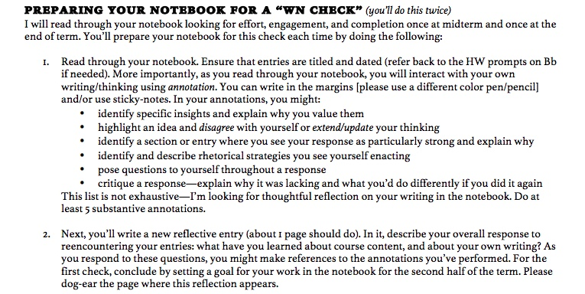
Annotation as Reflective Writing in the Writer’s Notebook
As in-situ or on-the-spot moments of metacognitive critical thinking

Slide 7
ANDREW a) R/W connection: seeing his own writing as a reader
Notes:
”I wish that I had used more words. I mean that, although because I wrote and understand the words, it is likely a new reader would have a hard time understanding parts of the second response. That’s fun though, right?”

Slide 8
ANDREW b) his interest in WORDS
Notes:
Top: annotation is him quoting himself – he finds this sentence about genre to be profound.
RIGHT: Similarly he names himself a “master of appositives” something we were practicing in our in class sentence style practice. I wrote the note, “Nice! Put that on your resume!”
LEFT: “I appreciated this activity because I treasure wordings of quotes and maxims that I love. This attests to the idea of a beautiful sentence composition, wherever it may be “hiding””

Slide 9
ANDREW b) interest in WORDS collides with preexisting sense of self
Notes:
Here Andrew says he’s “still a math minded guy” in an entry in his notebook. I come in with the annotation, “Nah. You just said you love quotes and maxims!”

Slide 10
MELISSA a) Reencountering as reevaluating performance and concepts
Notes:
Top: “This was my favorite article, but this entry is definitely one I did fast. SLOW DOWN!”
Bottom: “Looking back on this, I think the term ‘available means’ is also very important because not everything consists of every type of rhetoric. It is all about what means would enhance the argument”

Slide 11
MELISSA b) Rhetoric applied in her OWN writing
Notes:
Left: “Makes his whole essay stronger and is something I want to try to work into my essay to really wrap things up”
Right: “I do this in my inquiry essay” (that’s my smiley face, from when I’m assessing)

Slide 12
Outcomes/Benefits
annotation as reflective writing –
. . . a chance for writers to read a huge corpus of their own writing
. . . a chance to evaluate their own writing and thinking and skills
. . . a chance to solidify and question knowledge/concepts gained
It builds
. . . dynamic connections between reading/writing, composing/analyzing
. . . a dialogic assessment bridge
. . . a critical rhetorical HABIT, a method of engaging text, their own and published
(not just a discrete unit or paper in a class. Annotation everywhere!)
. . . Practice in “talking back” – to themselves! … a change to change their minds

Slide 13
annotation as reflective writing
for POWERFUL LITERACY
Ernest Morrell, Coyle Professor in Literacy Education at Notre Dame
“what does it mean to teach students to read powerfully?”
“reading as an action subsumes all that decoding and comprehension imply; but it involves much more that is about questioning a text and its author”
“We want students to engage texts, to interrogate texts, to demand meaning from texts, to talk back to texts; to juxtapose texts with their lived experiences, with their encounters with other texts, and with their rapidly expanding ideas about people and the world”
Inundated with information, “what we want a literate person to do is to be able to ask questions of any text that they read”
“Any text is an invitation to a critical conversation”
1
2
3
Notes:
1. Morrell, Ernest. “English Teaching as Teaching Students to Read the Word and the World.” Council Chronicle, Nov 2014, p. 28.
2. “Powerful Literacy – Ernest Morrell.” Youtube, uploaded by ND College of Arts and Letters, 28 August 2018, https://youtu.be/_q0bcdvwRgQ, (0:16)
3. p. 313, Morrell, Ernest. “Powerful English at NCTE Yesterday, Today, and Tomorrow: Toward the Next Movement.” Research in the Teaching of English , February 2015, vol. 49, no. 3, pp. 307-327.

