Slide 1
UNCC 5th Annual Conference on Writing Studies 19 October 2018 ruleh@mailbox.sc.edu
for accessibility and resources | visit hannahjrule.com for script, slides, and assignment description

Slide 2
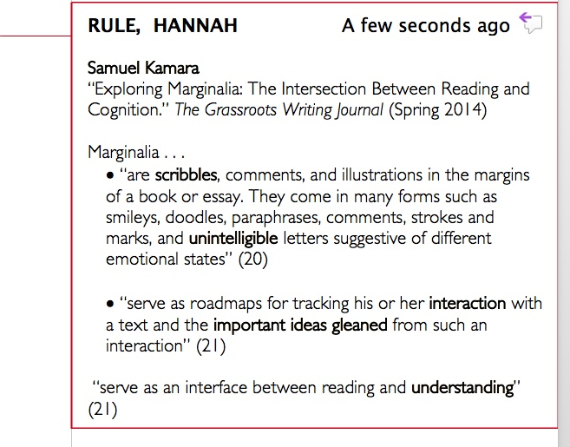
I. Annotation as Background Practice
annotation conventionally as . . .
Reading
personal, private
prelude to writing
→ as WRITING?

Slide 3
II. Annotation as Writing

Slide 4
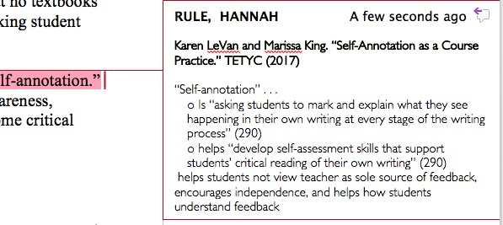
II. Annotation as Writing

Slide 5
III. Annotation EVERYWHERE
Introduce annotation, share annotation → link to reading like a writer, rhetorical reading
Routine practice at annotating to analyze written and visual texts of all kinds
Annotate sources as research step
My draft feedback as annotation
Students annotate their final work in the portfolio

Slide 6
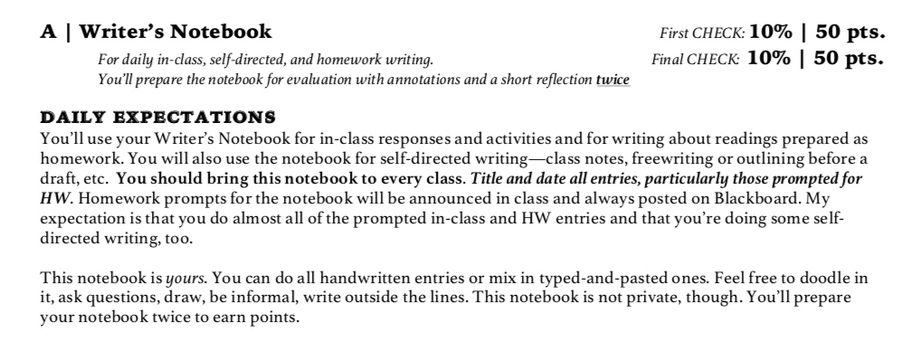
IV. Annotation in the Writer’s Notebook

Slide 7
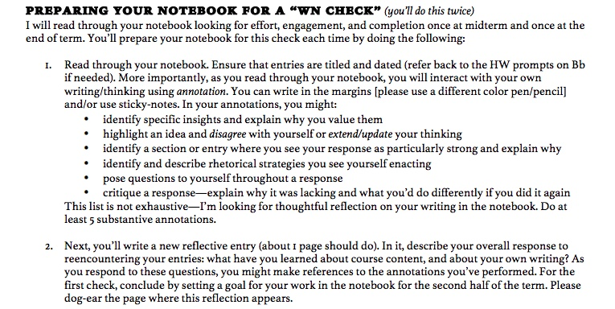
IV. Annotation in the Writer’s Notebook

Slide 8
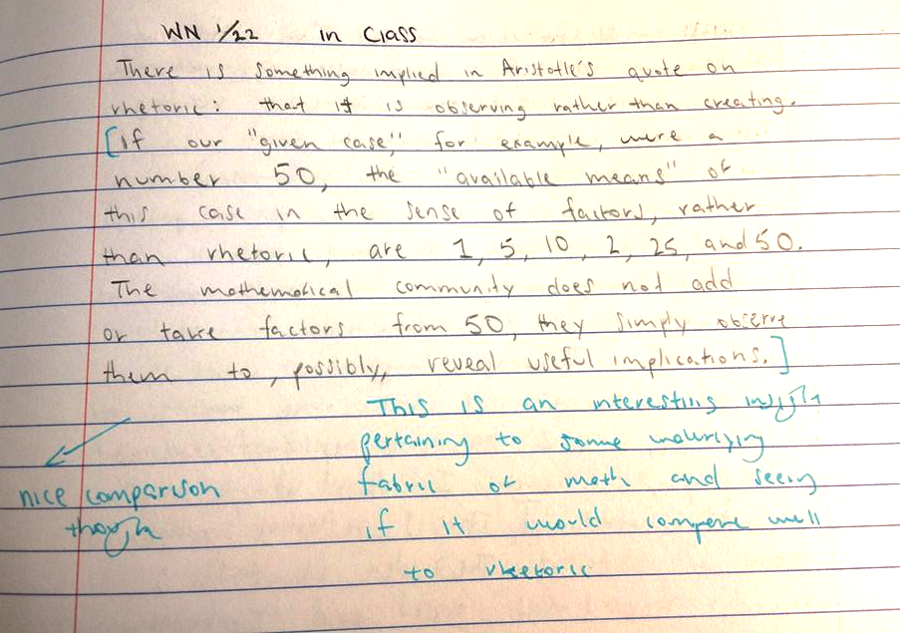
IV. Annotation in the Writer’s Notebook ANDREW a) RW connection: diagnosing his writing, reading it critically

Slide 9
IV. Annotation in the Writer’s Notebook ANDREW a) R/W connection: reading as a reader/writer his own writing

Slide 10
ANDREW b) his interest in WORDS

Slide 11
ANDREW b) his interest in WORDS

Slide 12
IV. Annotation in the Writer’s Notebook MELISSA a) Evaluative + reencountering concepts

Slide 13
IV. Annotation in the Writer’s Notebook MELISSA b) Rhetoric in her OWN writing

Slide 14
V. Outcomes
annotation as writing, as unifying method is –
. . . a dynamic connection between reading/writing, composing/analyzing processes
. . . a medium for reflection
. . . a dialogic assessment bridge
. . . a critical rhetorical HABIT, a new way of seeing
(not just a discrete unit or paper in the class)

Slide 15
thanks!
Hannah Rule, Asst. Professor University of South Carolina
ruleh@mailbox.sc.edu hannahjrule.com

